Slide 1
PROPERTY MANAGEMENT
SUJAL LUHAR

Slide 2
Specifications:
We are providing Students and Tenant rooms with world class facilities.
We take property from client, manage it so that client can get maximum return.
We charge client from their profit a commission.
We are the company which have trained professional in their own domains. Including, management, strategy and helpline department.

Slide 3
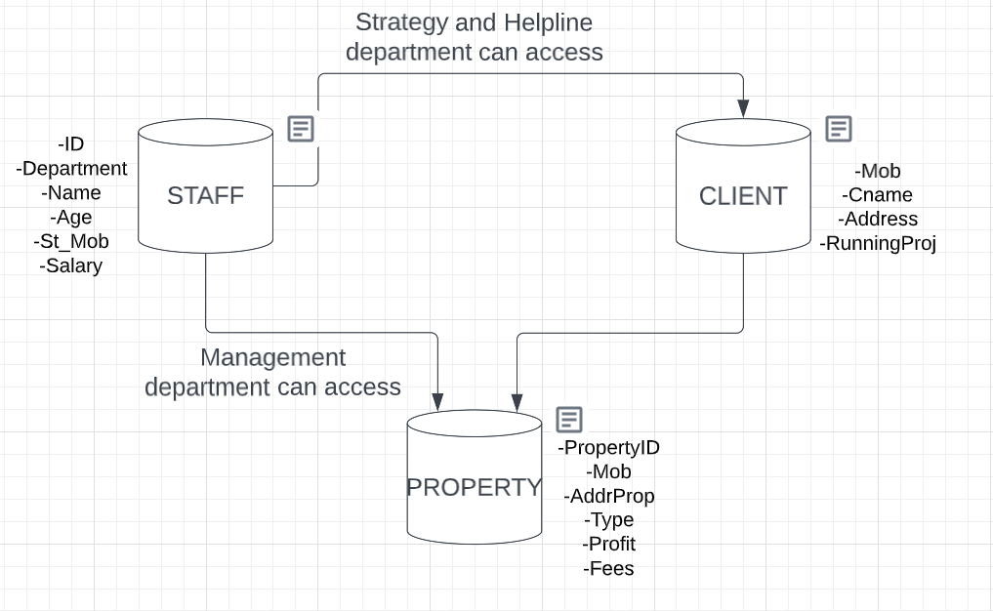
Overview

Slide 4
What else could we do:
Make new table to save details of studentLiving and tenant.
And manage their data also. Like, collecting feedbacks.
Or if a student want change the building but stay with our firm.

Slide 5
THANK YOU

